Slide 1
10 TRUTHS
EVERY CHRISTIAN SHOULD KNOW
Jesus Christ, Salvation & The Holy Spirit
Pastor Trevor Meers

Slide 2
What Have We Covered So Far?
The Trinity
Attributes of God
Scripture
Nature of Humanity
Sin

Slide 3
The Bible, like all sacred writings, contains helpful accounts of ancient myths but is not literally true.
2016: 17% of American evangelicals agree
2022: 26% of American evangelicals agree

Slide 4
Jesus was a great teacher, but He was not God.
2020: 30% of American evangelicals agree
2022: 43% of American evangelicals agree

Slide 5
God accepts the worship of all religions, including Christianity, Judaism and Islam.
2016: 48% of American evangelicals agree
2022: 56% of American evangelicals agree

Slide 6
Christology The study of the person, nature and role of Jesus Christ

Slide 7
Who was Jesus?

Slide 8
Many People Think Jesus Was…
A character from folklore. He never existed.
A failed prophet.
A wise teacher.
A violent revolutionary who failed to overthrow Rome.

Slide 9


Slide 10
The Incarnation
= Jesus taking on human flesh (Latin “carnis” means “flesh”)

Slide 11
Why The Incarnation Matters
Required for Jesus to reveal God to us and rescue us.
Jesus is exactly LIKE God because He IS God.
Helps us treasure the cross by understanding the life that preceded it.
Meant Jesus had human flesh, soul, mind and will.
Hypostatic union=Two natures (God AND human) in one man.

Slide 12
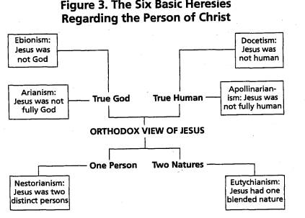

Slide 13
Why does all this deep stuff matter?
Only someone Who is both God and man could accomplish our salvation.

Slide 14
What Jesus Accomplished During His Incarnation
Lived a life of perfect obedience
Died a substitutionary death
Was buried
Rose victoriously
Ascended to Heaven to reign

Slide 15
Discuss: Which of the things listed on pg. 133 is easiest for you to focus on/believe? Which is hardest?
Forgiveness
Salvation
Justification
Reconciliation
Love
Adoption
Cleansing
Healing
Redemption
Freedom
Rescue
Triumph
Hope
Inheritance
Peace
Rest

Slide 16
Discuss: If Jesus really rose again, how does that change your fears and anxieties? If He is reigning right now, how does that change your fears and anxieties?

Slide 17
Pneumatology The study of the Holy Spirit (“pneuma”=breathe or spirit)

Slide 18
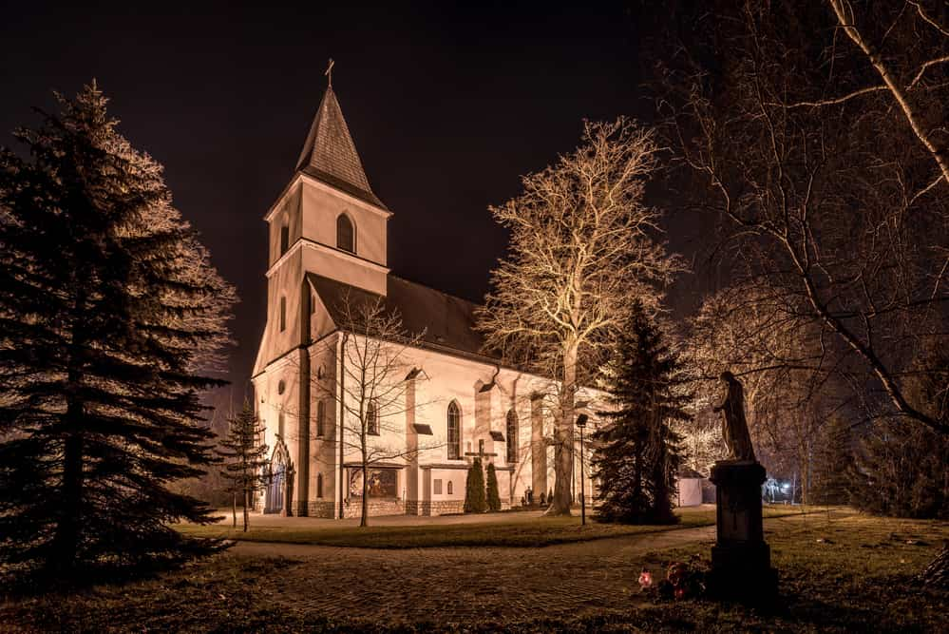

Slide 19
Common Misconceptions About the Holy Spirit
He is a force
He comes and goes
He is an emotion or feeling
He is dramatic
He is nice but not necessary

Slide 20
Key Truths About the Holy Spirit
He is a person
He is God
He proceeds from the Father and Son
He inspired Scripture
He is to be adored and glorified (worshipped)

Slide 21
Christ’s Accomplishments Applied Through the Holy Spirit
Regeneration

Slide 22
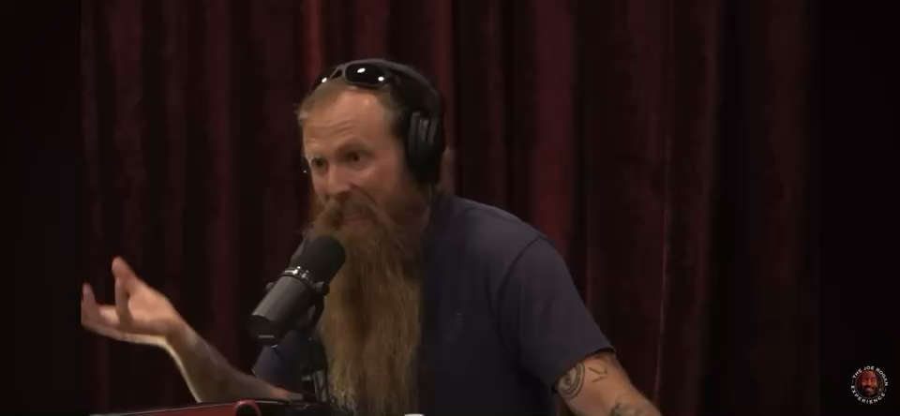

Slide 23
Christ’s Accomplishments Applied Through the Holy Spirit
Regeneration
Union with Christ
Sanctification
Perseverance & Glorification

Slide 24
Discuss: How have you seen the Spirit at work in your own sanctification?

Slide 25
Discuss: What doubts are addressed by the fact that the Holy Spirit seals and guarantees our salvation?

