Slide 2
10 TRUTHS
EVERY
CHRISTIAN
SHOULD KNOW
Dave Heisterkamp

Slide 3
What is a disciple?
What is theology?
Who is God?

Slide 4
What is a disciple?
“Christian” – 3 x’s
“The Way” – 5 x’s
“Disciple” – 260 x’s

Slide 5
But Saul, still breathing threats and murder against the disciples of the Lord, went to the high priest 2 and asked him for letters to the synagogues at Damascus, so that if he found any belonging to the Way, men or women, he might bring them bound to Jerusalem.
Acts 9:1,2

Slide 6
“The Way” = a traveled road, a worn path

Slide 7
Jewish educational system:

Slide 8
Jewish educational system:
“House of the Book” - between ages of 5-13 – memorize Torah

Slide 9
Jewish educational system:
“House of the Book” - between ages of 5-13 – memorize Torah
“House of Learning” – between ages of 13-17 memorize much of OT

Slide 10
Jewish educational system:
“House of the Book” - between ages of 5-13 – memorize Torah
“House of Learning” – between ages of 13-17 memorize much OT
Apprentice under a rabbi – 24/7/365

Slide 11
3 driving goals of the apprentice:

Slide 12
3 driving goals of the apprentice:
To be with your rabbi

Slide 13
3 driving goals of the apprentice:
To be with your rabbi
To become like your rabbi

Slide 14
3 driving goals of the apprentice:
To be with your rabbi
To become like your rabbi
To do as your rabbi did

Slide 15
3 driving goals of the follower of Jesus Christ:

Slide 16
3 driving goals of the follower of Jesus Christ:
To be with Jesus

Slide 17
3 driving goals of the follower of Jesus Christ:
To be with Jesus
To become like Jesus

Slide 18
3 driving goals of the follower of Jesus Christ:
To be with Jesus
To become like Jesus
To do as Jesus did

Slide 19
31 And he began to teach them that the Son of Man must suffer many things and be rejected by the elders and the chief priests and the scribes and be killed, and after three days rise again. 32 And he said this plainly. And Peter took him aside and began to rebuke him.

Slide 20
33 But turning and seeing his disciples, he rebuked Peter and said, "Get behind me, Satan! For you are not setting your mind on the things of God, but on the things of man." 34 And calling the crowd to him with his disciples, he said to them, "If anyone would come after me, let him deny himself and take up his cross and follow me.

Slide 21
35 For whoever would save his life will lose it, but whoever loses his life for my sake and the gospel's will save it. 36 For what does it profit a man to gain the whole world and forfeit his soul? 37 For what can a man give in return for his soul?

Slide 22
38 For whoever is ashamed of me and of my words in this adulterous and sinful generation, of him will the Son of Man also be ashamed when he comes in the glory of his Father with the holy angels.”
Mark 8:31-38

Slide 23
Three conditions to be considered Christ’s follower:

Slide 24
Three conditions to be considered Christ’s follower:
Deny self

Slide 25
Three conditions to be considered Christ’s follower:
Deny self
Take up your cross

Slide 26
Three conditions to be considered Christ’s follower:
Deny self
Take up your cross
Follow Jesus

Slide 27
The Great Commission:
“Go therefore and make disciples of all nations, baptizing them in the name of the Father and of the Son and of the Holy Spirit, 20 teaching them to observe all that I have commanded you. And behold, I am with you always, to the end of the age.”
Matthew 28:19-20

Slide 28
A disciple of Jesus is a committed follower, learner, worshiper, servant and witness of Jesus.

Slide 29
What is theology?

Slide 30
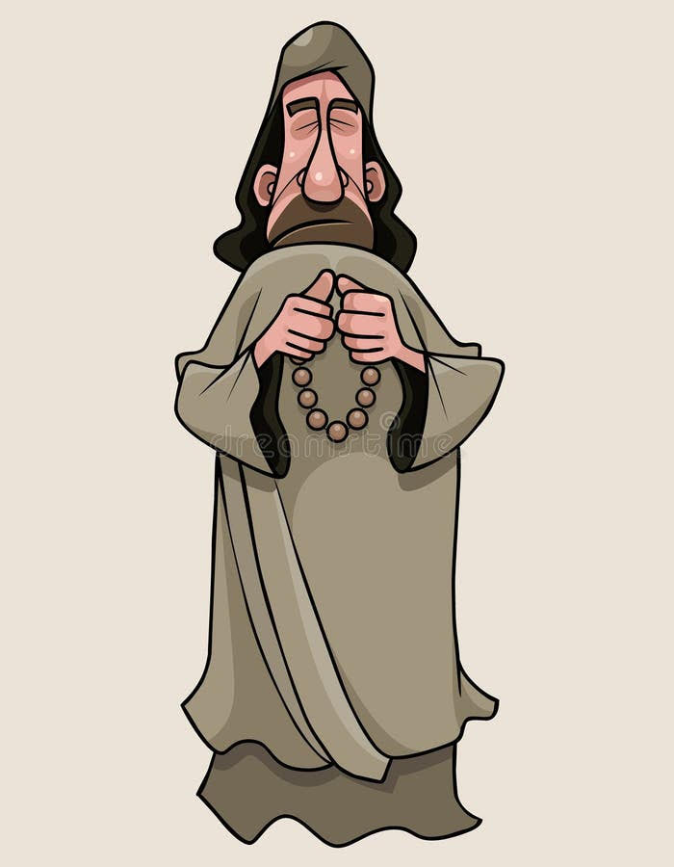

Slide 31
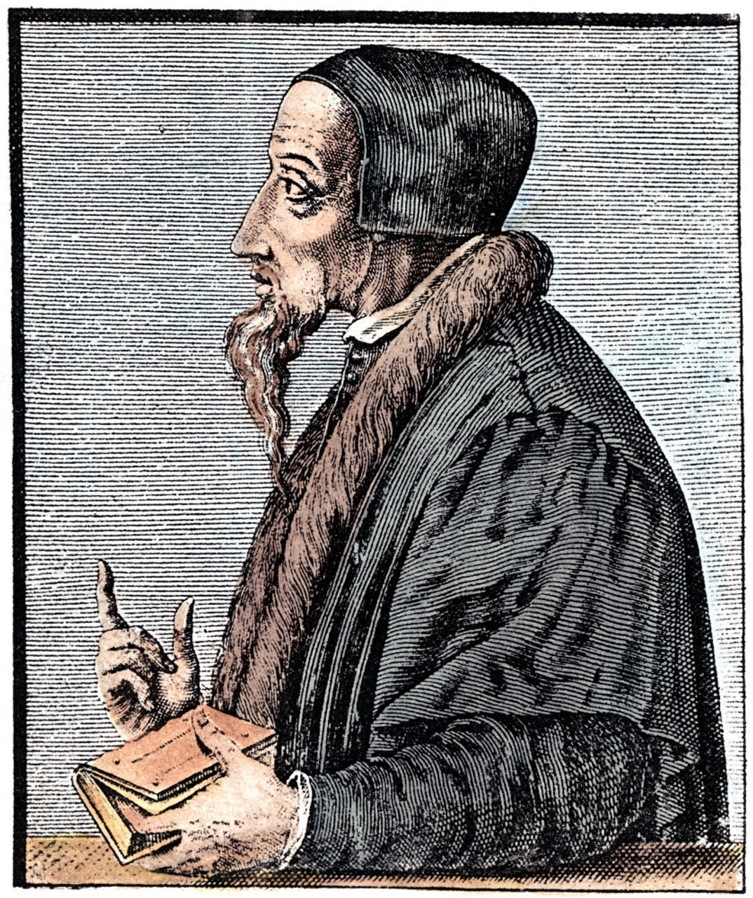

Slide 32
What is theology?
“Theos” = God; “logos” = the word

Slide 33
What is theology?
Theology is the study of who God is as He reveals Himself in Scripture!

Slide 34
Two basic presuppositions for the theologian:
The Bible is true and that it is, in fact, our only absolute standard of truth

Slide 35
Two basic presuppositions for the theologian:
The Bible is true and that it is, in fact, our only absolute standard of truth
The God Who is spoken of in the Bible exists, and He is Who the Bible says He is.

Slide 36
Five ways theology is to be done?

Slide 37
Five ways theology is to be done?
Biblically (II Tim 3:16,17)

Slide 38
Five ways theology is to be done?
Biblically (II Tim 3:16,17)
Prayerfully (Ps 119:18; I Cor 2:14)

Slide 39
Five ways theology is to be done?
Biblically (II Tim 3:16,17)
Prayerfully (Ps 119:18; I Cor 2:14)
Humility (I Peter 5:5)

Slide 40
Five ways theology is to be done?
Biblically (II Tim 3:16,17)
Prayerfully (Ps 119:18; I Cor 2:14)
Humility (I Peter 5:5)
Worshipfully (Ps 19:8; 119:14, 103, 111)

Slide 41
Five ways theology is to be done?
Biblically (II Tim 3:16,17)
Prayerfully (Ps 119:18; I Cor 2:14)
Humility (I Peter 5:5)
Worshipfully (Ps 19:8; 119:14, 103, 111)
Community (Hebrews 10:23-25)

Slide 42
“Theology is not done exclusively or even primarily in a classroom, it is done in everyday life”
“Doing theology is the work of mind renewal for the purpose of heart transformation”
“The heart cannot love what the mind does not know”

Slide 43
Who is God?
“What comes into our minds
when we think about God
is the most important thing about us”
A.W. Tozer

Slide 44
The Doctrine of the Trinity

Slide 45
The Doctrine of the Trinity
God eternally exists as one essence and three distinct persons: God the Father, God the Son, and God the Holy Spirit. Each person is fully God, yet there is one God.

Slide 46
The Doctrine of the Trinity
The word “Trinity” is not found in the Bible! It is Latin for “three”. The Bible was originally written in Hebrew (most of OT); Aramaic (small portions of the OT), and Greek (the NT).

Slide 47
The Doctrine of the Trinity
The theological word “Trinity” means:
“Tri-unity”
“Three-in-oneness”

Slide 48
The Trinity teaches God is:
The Trinity teaches God is:
One in essence.
Three in persons.

Slide 49
The truth of the Trinity is shown in the Bible:

Slide 50
The truth of the Trinity is shown in the Bible:
There is one God. (Deut 6:4; Isa 45:5)

Slide 51
The truth of the Trinity is shown in the Bible:
There is one God. (Deut 6:4; Isa 45:5)
The one God exists in three Persons:

Slide 52
The truth of the Trinity is shown in the Bible:
There is one God. (Deut 6:4; Isa 45:5)
The one God exists in three Persons:
The Father is God – Rom 1:7; I Peter 1:2
The Son is God – Jn 1:1; 10:30; 20:28
The Spirit is God – Jn14:16,17; Acts 5:3,4)
1 x 1 x 1 = 1

Slide 53
The truth of the Trinity is shown in the Bible:
The Father, Son and Spirit are each distinct from one another:

Slide 54
The truth of the Trinity is shown in the Bible:
The Father, Son and Spirit are each distinct from one another:
The Father sent the Son – John 3:16
The Son is obedient to the Father, even to death on the cross – Phil 2:8
The Holy Spirit is sent by the Father and the Son - Jn 14:16,17. He is often referred to as the servant member of the Trinity.

Slide 55
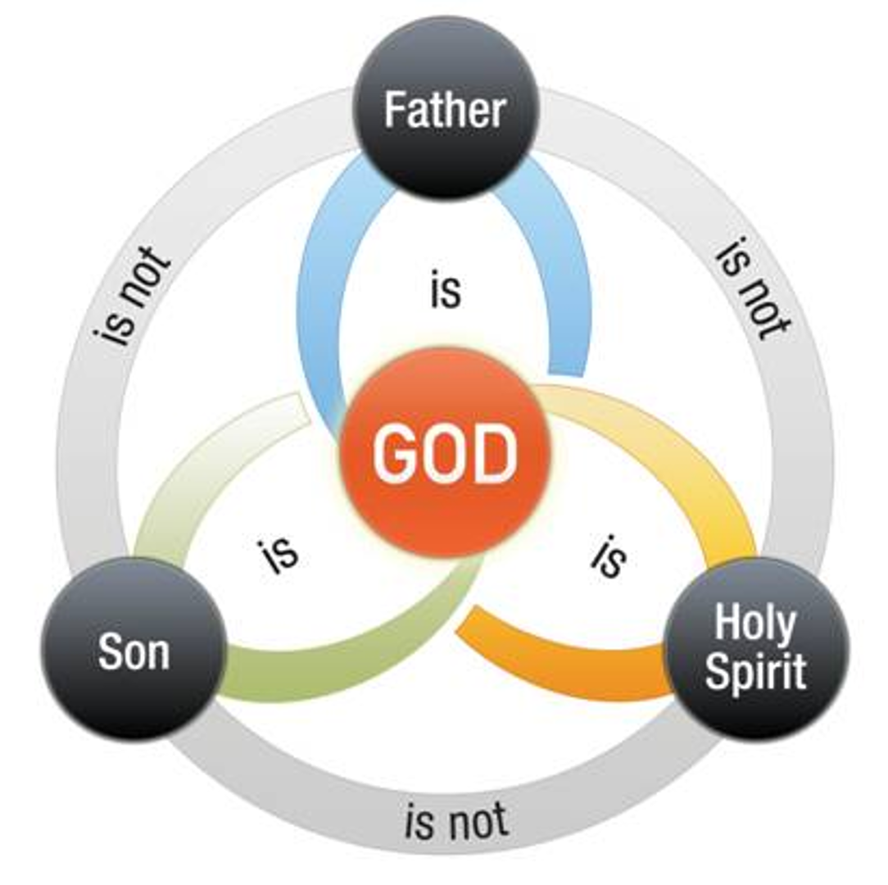

Slide 56
Glimpses of the Trinity:
First name for God in the Bible is “Elohim” = the plural form of God -Genesis 1:1

Slide 57
Glimpses of the Trinity:
First name for God in the Bible is “Elohim” = the plural form of God -Genesis 1:1
Use of plural pronouns – God speaks of Himself as “Us” – Gen 1:26; 3:22; 11:7; Isa 6:8

Slide 58
Glimpses of the Trinity:
First name for God in the Bible is “Elohim” = the plural form of God -Genesis 1:1
Use of plural pronouns – God speaks of Himself as “Us” – Gen 1:26; 3:22; 11:7; Isa 6:8
A believer is baptized in the ”name of the Father, and the Son, and the Holy Spirit” (“name” is singular)

Slide 59
Glimpses of the Trinity:
Paul’s prayer in II Cor 13:14 “The grace of of our Lord Jesus Christ, and the love of God, and the fellowship of the Holy Spirit”

Slide 60
Glimpses of the Trinity:
Paul’s prayer in II Cor 13:14 “The grace of of our Lord Jesus Christ, and the love of God, and the fellowship of the Holy Spirit”
Jesus’ promise to the disciples in John 14:16,17 – Jesus says he will ask the Father for the Spirit to be sent.

Slide 61
10 TRUTHS
EVERY
CHRISTIAN
SHOULD KNOW
Dave Heisterkamp

