Slide 1
10 TRUTHS
EVERY
CHRISTIAN
SHOULD KNOW
Peter Atwell

Slide 2
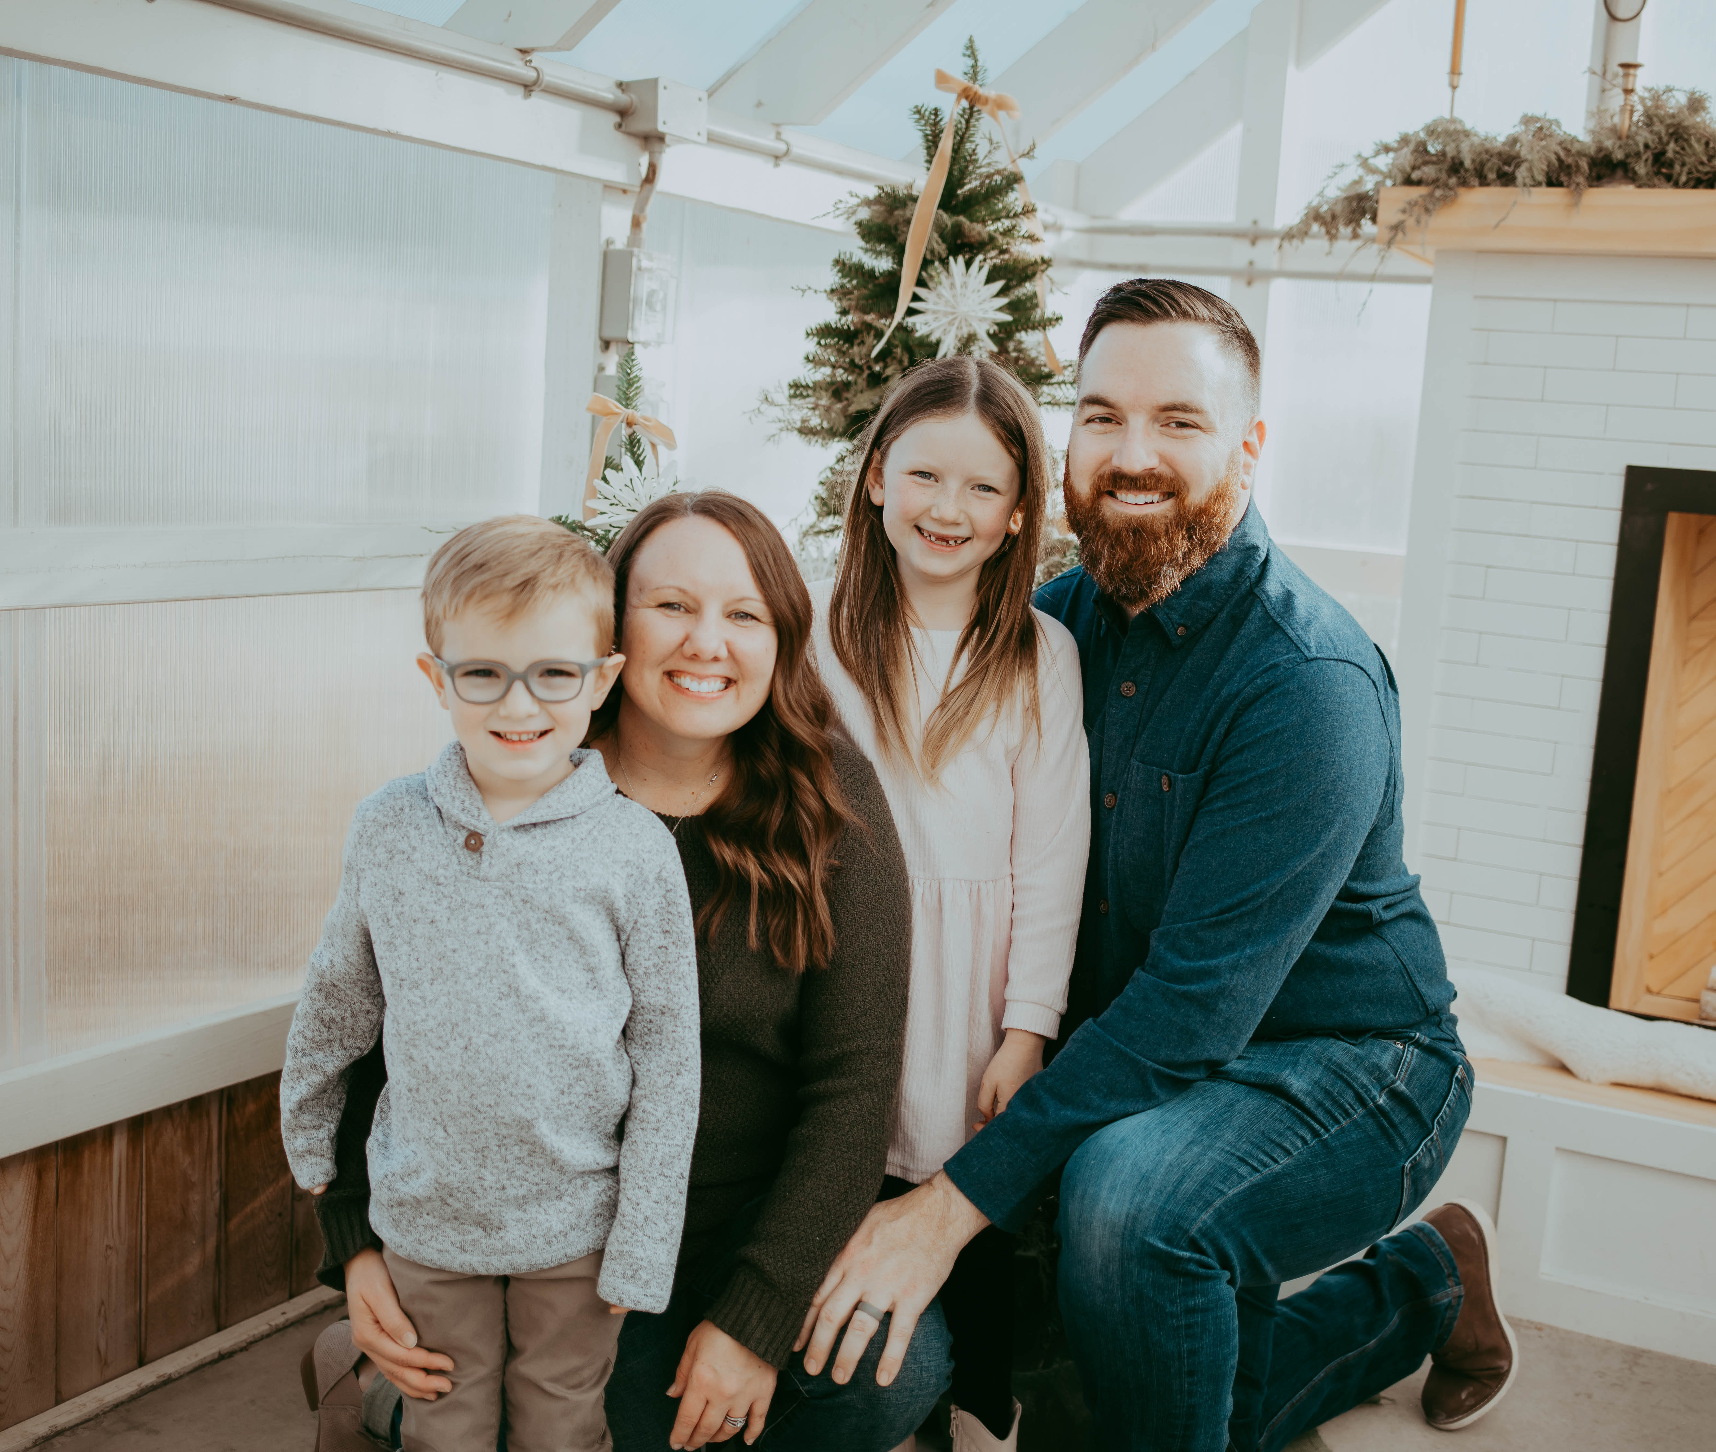

Slide 4
Share at your table a trait you see in one of your children, or in yourself from your parents

Slide 6
Chapter 3-What is God Like?

Slide 8
Attribute defined- A quality or feature regarded as a characteristic or inherent part of someone or something

Slide 9
Share some traits of your spouse, child, other loved ones

Slide 11


Slide 13


Slide 15
When we __LOVE__ those close to us, we __ENJOY__ learning about them so we can please them.

Slide 17
As we grow in __KNOWLEDGE__ of God, our __LOVE__ for Him will increase!

Slide 19
Communicable vs Incommunicable

Slide 21
Incommunicable attributes are __GOD’s__ alone.

Slide 23
Communicable attributes can be seen in __HUMANS__.

Slide 25
If our increased knowledge leads to increased love, this should help us glorify God more

Slide 27
Royal Friends

Slide 29
What should our increased knowledge and love of God drive us to do?
EVANGELISM!!!!

Slide 31
Break Time!

Slide 33
Chapter 4-What is the Bible?

Slide 34
Revelation
End Times?

Slide 35
Doctrine of Revelation

Slide 36
Two types of Revelation--__GENERAL__ & __SPECIAL__

Slide 38
General Revelation

Slide 40
General Revelation is __LIMITED__

Slide 42
Special Revelation

Slide 43
God reveals the story of Jesus through __SCRIPTURE__

Slide 45
Attributes of Scripture

Slide 46
INSPIRED

Slide 47
INSPIRED
AUTHORITATIVE

Slide 48
INSPIRED
AUTHORITATIVE
INERRANT

Slide 49
INSPIRED
AUTHORITATIVE
INERRANT
INFALLIBLE

Slide 50
INSPIRED
AUTHORITATIVE
INERRANT
INFALLIBLE
NECESSARY

Slide 51
INSPIRED
AUTHORITATIVE
INERRANT
INFALLIBLE
NECESSARY
SUFFICIENT

Slide 52
INSPIRED
AUTHORITATIVE
INERRANT
INFALLIBLE
NECESSARY
SUFFICIENT
CLEAR

Slide 54
10 TRUTHS
EVERY
CHRISTIAN
SHOULD KNOW
Peter Atwell

