Slide 2
Elijah’s Farewell 2 Kings 2:1-18
Pastor Joel Newman

Slide 3
¹⁷ Elijah was a man with a nature like ours, and he prayed fervently that it might not rain, and for three years and six months it did not rain on the earth. ¹⁸ Then he prayed again, and heaven gave rain, and the earth bore its fruit.
James 5:17-18

Slide 4
How to Live and Finish Well
Remain Faithful to Follow God

Slide 5
And Elijah said to Elisha, “Please stay here, for the Lord has sent me as far as Bethel.” But Elisha said, “As the Lord lives, and as you yourself live, I will not leave you.”
2 Kings 2:2

Slide 6
And he took up the cloak of Elijah that had fallen from him and went back and stood on the bank of the Jordan. ¹⁴ Then he took the cloak of Elijah that had fallen from him and struck the water, saying, “Where is the Lord, the God of Elijah?” And when he had struck the water, the water was parted to the one side and to the other, and Elisha went over. ¹⁵ Now when the sons of the prophets who were at Jericho saw him opposite them, they said, “The spirit of Elijah rests on Elisha.”
2 Kings 2:13-15

Slide 7
How to Live and Finish Well
Remain Faithful to Follow God
Remember God’s Faithfulness

Slide 8
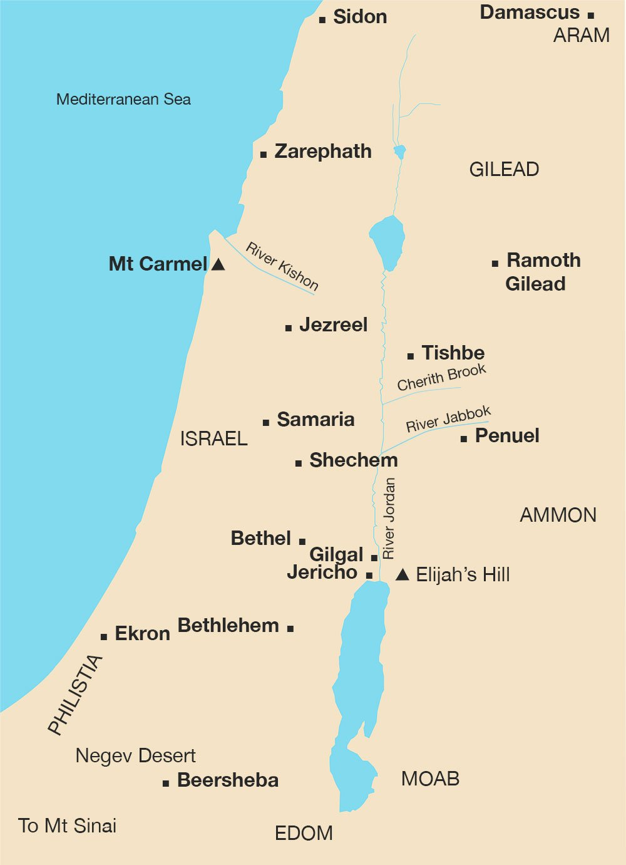
Elijah’s Farewell Tour
Gilgal- Joshua 4:19-24

Slide 9
Elijah’s Farewell Tour
Gilgal- Joshua 4:19-24
Bethel-Genesis 28:10-19

Slide 10
Elijah’s Farewell Tour
Gilgal- Joshua 4:19-24
Bethel-Genesis 28:10-19
Jericho-Joshua 6

Slide 11
Elijah’s Farewell Tour
Gilgal- Joshua 4:19-24
Bethel-Genesis 28:10-19
Jericho-Joshua 6
Jordan River-Joshua 4

Slide 12
How to Live and Finish Well
Remain Faithful to Follow God
Remember God’s Faithfulness
Roused by the Glorious Day

Slide 13
And as they still went on and talked, behold, chariots of fire and horses of fire separated the two of them. And Elijah went up by a whirlwind into heaven. ¹² And Elisha saw it and he cried, “My father, my father! The chariots of Israel and its horsemen!” And he saw him no more.
2 Kings 2:11-12

Slide 14
We are Designed for Eternity
God was not done with Elijah
Luke 9:30-31
Revelation 11:3,6

Slide 15
We are Designed for Eternity
We are Destined for Eternity

Slide 16
1 Thessalonians 4:13-18
But we do not want you to be uninformed, brothers, about those who are asleep, that you may not grieve as others do who have no hope. ¹⁴ For since we believe that Jesus died and rose again, even so, through Jesus, God will bring with him those who have fallen asleep. ¹⁵ For this we declare to you by a word from the Lord, that we who are alive, who are left until the coming of the Lord, will not precede those who have fallen asleep.

Slide 17
¹⁶ For the Lord himself will descend from heaven with a cry of command, with the voice of an archangel, and with the sound of the trumpet of God. And the dead in Christ will rise first. ¹⁷ Then we who are alive, who are left, will be caught up together with them in the clouds to meet the Lord in the air, and so we will always be with the Lord. ¹⁸ Therefore encourage one another with these words.

Slide 18
Revelation 20:11-15
¹¹ Then I saw a great white throne and him who was seated on it. From his presence earth and sky fled away, and no place was found for them. ¹² And I saw the dead, great and small, standing before the throne, and books were opened. Then another book was opened, which is the book of life. And the dead were judged by what was written in the books, according to what they had done.

Slide 19
¹³ And the sea gave up the dead who were in it, Death and Hades gave up the dead who were in them, and they were judged, each one of them, according to what they had done. ¹⁴ Then Death and Hades were thrown into the lake of fire. This is the second death, the lake of fire. ¹⁵ And if anyone's name was not found written in the book of life, he was thrown into the lake of fire.

Slide 20
How to Live and Finish Well
Remain Faithful to Follow God
Remember God’s Faithfulness
Roused by the Glorious Day

